Slide 1
Restorative Language (based on Restorative Justice)
Valeria Troya-McCann & Scott Ighavongbe-Patrick
Bucks Educational Psychology Service
Notes:
Introduce yourself: TEP from UCL, doing Doctorate study in RC, working at Bucks.

Slide 2
Aims of the workshop
To introduce you to the concept of restorative justice (RJ).
To introduce you to the ethos and values that underpin restorative justice.
To introduce you to the skills that will allow you to use restorative language successfully.
Notes:
The values and skills underpinning RJ also needs to be the values and skills of a restorative practitioner.

Slide 3
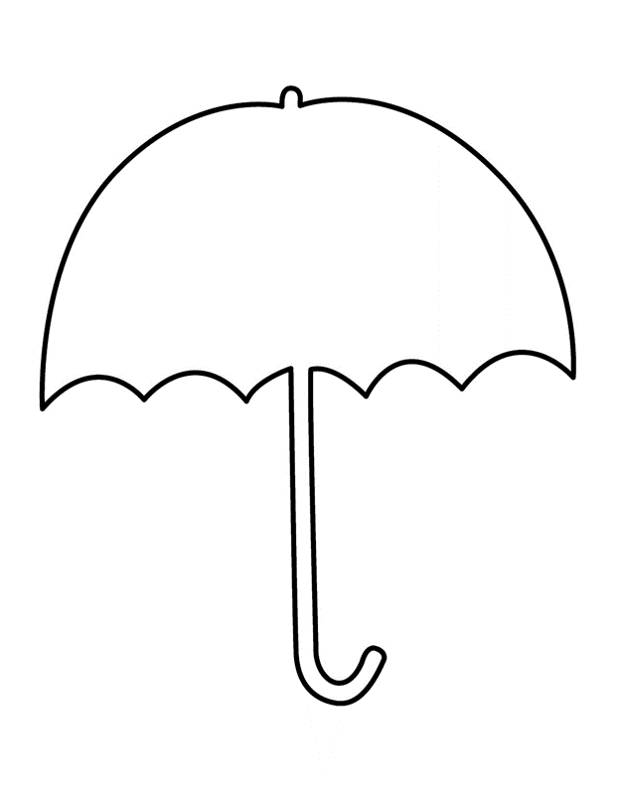
Restorative Justice
Restorative
Conversation
Notes:
RJ is the framework that covers RC. That is why half of the workshop, I will be explaining what RJ is and then introduce RC. Please don’t get confused as they are very close together. RC is simply a smaller version of RJ and really is the main tool of RJ. It is the set of questions that RJ uses to explore facts and encourage restoration.

Slide 4
What is Restorative Justice (RJ)?
“Restorative Justice is a way to move a child on. For years we’ve just been containing – putting the lid back on – and eventually that just explodes in your face!”
Primary Deputy Head, Banbury (Hopkins, 2004)

Slide 5
What is RJ?
A value-based approach for responding to wrongdoing and conflict.
An approach that focuses on building and repairing relationships rather than simply managing and controlling behaviour.
An approach that considers wrongdoing/ misbehaviour as breach to human relationships rather than to school rules.
An approach that utilises incidents of wrongdoing as an educative opportunity for repairing the harm.
Notes:
RJ uses the incident of misbehaviour as an educative opportunity for repairing the harm, by fostering more socially responsible relationships and behaviours that take others’ perspectives into account.

Slide 6
RJ is not…
A ‘soft approach’ which ignores bad behaviour or doesn’t give consequences for it.
Primarily about forgiveness and reconciliation.
Necessarily designed to reduce bad behaviour but this is what I want to explore!
A ‘magic wand’ that will transform your students immediately.
A replacement for your behavioural policy.
Notes:
Your behavioural policy has to be a back up for major incidents.

Slide 7
What does RJ entail?
RJ entails a commitment to:
Facilitate dialogue between all those involved in, and affected by wrongdoing or conflict.
Encourage those responsible for wrongdoing to become accountable for their actions and to accept responsibility for putting right the wrong.
Ensure that all those involved or affected are given the opportunity to share their story, their feelings and their needs.
Involve everyone affected in finding mutually acceptable ways to move forward.
Repair the harm caused by any behaviour that has a negative impact on others.
Repair and/ or build relationships between those affected.
Notes:
In other words, RJ is all about relationships – making, maintaining and, when necessary, repairing relationships.

Slide 8
Traditional approach
What’s happened?
Who started it?
What response is appropriate to deter and punish?
Notes:
In other words, RJ is all about relationships – making, maintaining and, when necessary, repairing relationships.

Slide 9
Restorative approach
What’s happened?
Who has been affected or harmed?
How can those involved be supported in finding ways to repair the harm caused?
Notes:
In other words, RJ is all about relationships – making, maintaining and, when necessary, repairing relationships.

Slide 10
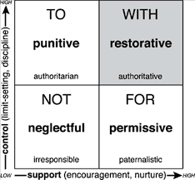
The Social Discipline Window Wachtel & Costello (2009)
Notes:
The underlying premise of RJ Practices rests with the belief that people will make positive changes when those in positions of authority do things with them rather than to them or for them. Wachtel & Costello (2009), The Restorative Practices Handbook, pg 50

Slide 11
Paradigm shift
Traditional approach | RJ approach
School and rules violated Justice focuses on establishing guilt Accountability = punishment Attention is directed to the wrongdoer, harmed ignored Rules and intent outweigh whether outcome is positive/negative No opportunity for remorse or amends | People and relationships violated Justice identifies needs and obligations Accountability = understanding impact, repairing harm Wrongdoer, harmed and school all have direct roles in justice process Wrongdoer, harmed and school all have direct roles in justice process Opportunity given for amends and expression of remorse

Slide 12
How do we achieve restoration in relationships?
Through carefully structured opportunities for students to understand the impact of their actions, recognise their social responsibilities and make amends to those who have been affected.
Focusing on the person harmed (victim), the person causing the harm (wrong doer), and the affected community (the school or the classroom).

Slide 13
Achieving restoration following an incident…
Harmed | Caused harm
Someone to listen to my story. Time to calm down. The other person to understand and acknowledge the impact of their behaviour. Sincere apology. Things put right, if possible. | Time to think. Someone to listen to my story. A chance to explain what happened (why I did it). An opportunity to apologise and make amends. The opportunity to move on.

Slide 14

Restorative Justice
Harms and Needs
Collective
Participation
Obligations
Notes:
A process of collectively participation in identifying and addressing harms, needs, and obligations, in order to heal and put things as right as possible.

Slide 15
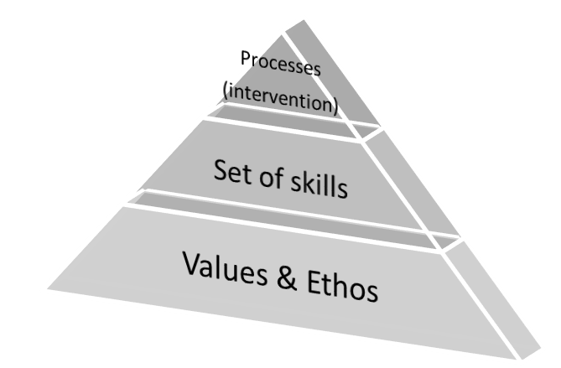
There is more to RJ than the Process?
Notes:
These are the values and skills that need to be underpinning restorative practice and so first and foremost they need to be the values and skills of a restorative practitioner

Slide 16
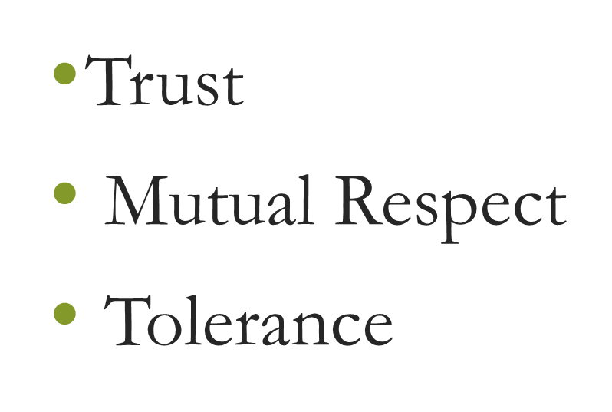
RJ Values
Values that underpin a commitment to building, maintaining & repairing relationships
Notes:
RJ is grounded in values that promote both accountability and healing for all affected.

Slide 17
All of this is based on 5 key “Rs”
Respect – listening to others opinions and valuing them.
Responsibility – taking responsibility for your own actions.
Repair – talking with others to sort out how to repair any harm that has been caused.
Re-integration – working through a process that solves the problem but allows all young people to remain included and involved in mainstream education.
Relationships – making them, not breaking them.

Slide 18
Activity 1 Reflecting on your practice
What informs your practice when dealing with wrongdoing or conflict?
Do you invite people to give you, individually, their perspective on what has happened?
Are you genuinely curious about their thoughts and feelings at the time of the incident and since?
Do you invite them to consider who else may have been affected?
Do you invite them to consider what needs to happen to put matters right?
Do you ask them what their own personal needs are for closure and repair?
Do you manage to refrain from:
Using your body or your tone to show disapproval?
Giving your own opinion or judgement about what has happened?
Taking sides?
Assuming you know what has happened and why?
Telling people what they should do?
Offering unasked for advice?
Insisting people apologise and make up?
Notes:
Is your response informed by relationship values and skills?

Slide 19

Restorative Language…
A simpler version of the restorative conference.
It is based on a formal scripted process that can be used when an incident has been unresolved or requires further action.

Slide 20
Five key questions…
Can you tell me what happened?
What were you thinking at the time?
How were you feeling at the time?
Who has been affected by what you’ve done? And in what way?
What do you need to do to put things right and everyone can move on?
Notes:
What is the question that is not there? Why!! They need to be asked in order, the whole set beginning with the wrongdoer if possible.

Slide 21
Before using the questions…
When necessary let the students calm down first.
Provide enough time to talk.
Create a safe environment (feeling comfortable, quiet and private place)
Set some ground rules.
Let the students come up with their own solution. Remember, you are facilitating the process not making decisions for them.

Slide 22

The skills for using restorative conversation
Stay curious (inquiry) – ‘’help me understand how you see things’
Remain impartial, not judging.
Respect other’s view on things.
Listen to others.
Develop rapport.
Notes:
Stay curious, not judgemental.

Slide 23
And…
Allow and empower participants to come up with their own solutions.
Expand on answers – creative questioning.
Be compassionate.
Be patient and allow silence if necessary.

Slide 24
Active Listening…
Empathetic Listening | Body Language
Valuing the speaker. Tuning in with the speaker’s words and feelings Curiosity. Feelings are important. Self-awareness. | Making eye contact. Smiling encouragingly. Leaning forward. Sitting still. Looking interested in what the student is saying.
Notes:
When people don’t feel heard they keep repeating themselves.
Self-awareness: remain in touch with the stories we are saying and others are saying. Be aware of what these stories produce is us (feelings and thoughts). This will help us remain objective and keep listening.

Slide 25
Creative questioning/Reflecting back
To encourage students self-reflection and keep the rapport going:
“So, what you are saying is…”
“Let me just check, I have understood what you said…”
“ I can see this really upset you...”
Repeating the last few words of the sentence can be useful.

Slide 26
Be patient and allow silence
Give students time to think.
Try to feel comfortable with silence (I know it’s very hard!).
Silence – with an interested look on one’s face.

Slide 27

Activity. Practice your new skills!
Notes:
Break off into groups of three’s
In your group decide on a facilitator, a harmed and a wrong doer.
The facilitator should practice using the 5 magic questions to repair a conflict situation.
Try to draw on your learned restorative justice skills

Slide 28
Any Questions?
Your feedback, please!

Slide 29

Take home messages…
RJ is about building relationships and not only modifying behaviour.
RJ is not about ignoring consequences.
RL is a smaller version of RJ that deals with relatively ‘light’ events.
RL needs to happen in a safe environment.
It’s not only about WHAT you do but HOW you do it. So, use your skills.

Slide 30
Thank you!
Valeria Troya-McCann
Scott I-Patrick
Bucks Educational Psychology Service

Slide 31
References:
Hopkins, B. (2004). Just Schools: A Whole School Approach to Restorative Justice (First ed.). London: Jessica Kingsley Publishers.
Zehr, H. (2002). The Little Book of Restorative Justice (First ed.). Pensilvannia: Good Books.
Starbuck, J. (2015). Restorative Justice workshop [PowerPoint presentation].

